Slide 1
Welcome to
Introduction to Python

Slide 2
Objectives
SQL Injection Attacks and Defense
Module 1: What is SQL injection?
Upon completion of this lesson, students will be able to do the following:
Explain how Python works.
Understand the proper use of Local and Global Variables.
Explain how to create and use functions
Identify Python's data types.
Call functions.
Display information based on the users input.

Slide 3
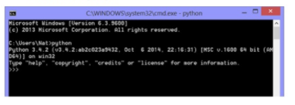
Introduction to Python
Module 1: Python Basics
Running Python
Python Interpreter is necessary to run Python code
Mac or Linux machine already installed
Windows download for free at https://www.python.org/downloads
Open Python Interpreter by typing python at a terminal window or shell prompt

Slide 4
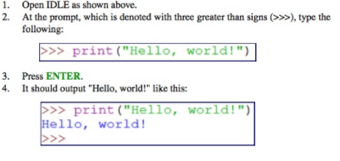
Introduction to Python
Module 1: Python Basics
Hello, World!

Slide 5

Introduction to Python
Module 1: Python Basics
Python Comments
The hash mark (or pound sign) indicates a comment
Everything after the hash mark on the same line is ignored
Multi-line strings can be used to create multi-line comments
Use triple quotes to create multi-line strings

Slide 6
Introduction to Python
Module 1: Python Basics
Variables
Variables are untyped and do not need to be declared
Simply assign a value to a variable—Python determines the type by the value assigned
Variable Names are
Case sensitive
Conventionally written in all lowercase letters
Words are separated by underscores
Must begin with a letter or an underscore
May contain only letters, digits, and underscores

Slide 7

Introduction to Python
Module 1: Python Basics
Variable Assignment
Three parts to variable assignment
Variable name.
Assignment operator.
Value assigned. This could be any data type.

Slide 8

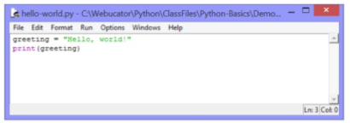
Introduction to Python
Module 1: Python Basics
Variable Assignment
To run this code:
Open the file in IDLE
Select Run>Run Module or press F5.

Slide 9
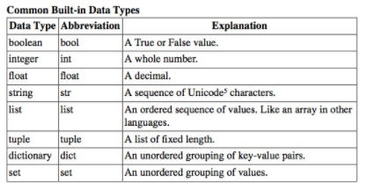
Introduction to Python
Module 1: Python Basics
Data Types
Data type determines
What an object can be
What can be done to it

Slide 10
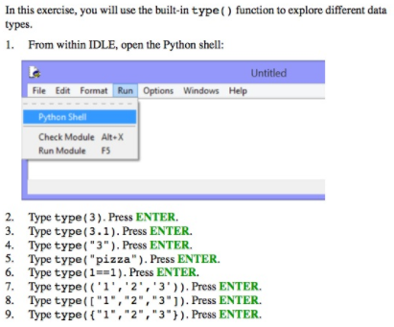
Introduction to Python
Module 1: Python Basics
Exercise 2: Exploring Types

Slide 11
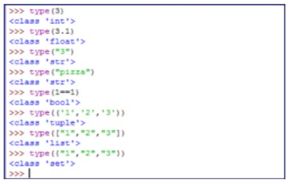
Introduction to Python
Module 1: Python Basics
Exercise 2: Exploring Types
Exercise Solution
The shell should appear as follows:

Slide 12
Introduction to Python
Module 1: Python Basics
Simultaneous Assignment
Python allows for simultaneous assignment.
Simultaneous assignment is useful as a shortcut for assigning several values at once.
Syntax follows:

Slide 13

Introduction to Python
Module 2: Functions and Modules
Defining Functions
Functions are defined using the def keyword

Slide 14
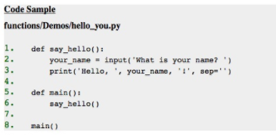
Introduction to Python
Module 2: Functions and Modules
Defining Functions
The code works in the same way, but the meat of the program has been moved out of the main() function and into another function. This is common. Usually, the main() function handles the flow of the program, but the actual "work" is done by other functions in the module.

Slide 15
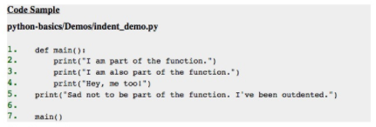
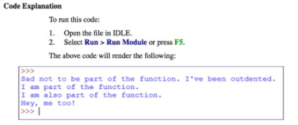
Introduction to Python
Module 1: Python Basics
The main () Function

Slide 16
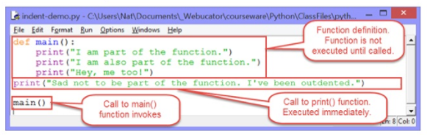
Introduction to Python
Module 1: Python Basics
The main () Function
Notes about function:
Functions are created using the def keyword.
The convention for naming functions is the same as that for variables: use all lowercase letters and separate words with underscores.

Slide 17
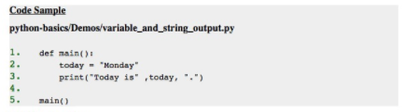
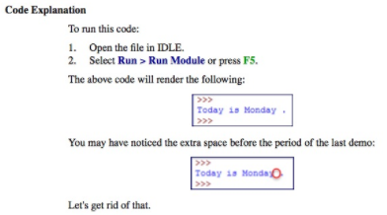
Introduction to Python
Module 1: Python Basics
print () Function

Slide 18
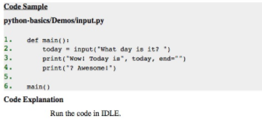
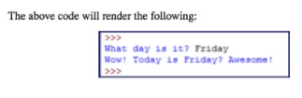
Introduction to Python
Module 1: Python Basics
Collecting User Input

